Slide 1
Self-Supervised 3D Human Pose Estimation in Sports Aerial Videos
Advisor: Prof. Giacomo Boracchi
Angelo Attivissimo
Co-advisor: Diego Martin
Academic year: 2024-2025

Slide 2
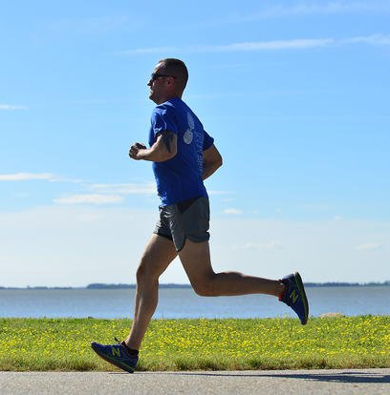
Introduction: Understanding Human Movement
Notes:
Quando guardiamo atleta compiere un movimento, il nostro cervello capisce come il corpo si sta muovendo: come il movimento si sta evolvendo nel tempo
Per una macchina e’ decisamente piu’ complesso.

Slide 3
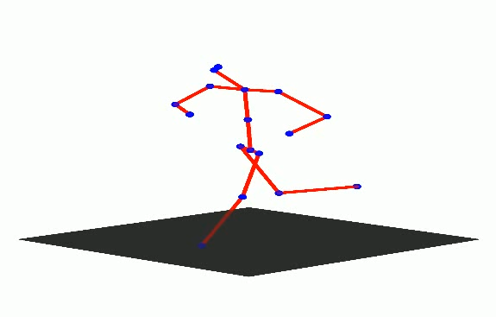
Introduction: Understanding Human Movement
Human Pose Estimation is a Computer Vision task that estimates the spatial and temporal structure of the human body from visual data.
Notes:
Le soluzioni che utilizzano solamente dati visivi, rientrano in operazione della CV nota come HPE.
Struttura Spaziale e Temporale della posa da dati visivi

Slide 4
Introduction: Understanding Human Movement
Human Pose Estimation is a Computer Vision task that estimates the spatial and temporal structure of the human body from visual data.
One key application of Human Pose Estimation is sports analysis:
Quantitative analysis of athletic performance
Identification of suboptimal or inefficient movement patterns
Injury prevention through biomechanical assessment
Notes:
Applicazione HPE e’ Analisi Sportiva: ricostruendo il movimento con un modello di CV possiamo:
Performance
Movimenti Inefficienti
Prevenire Infortuni

Slide 5
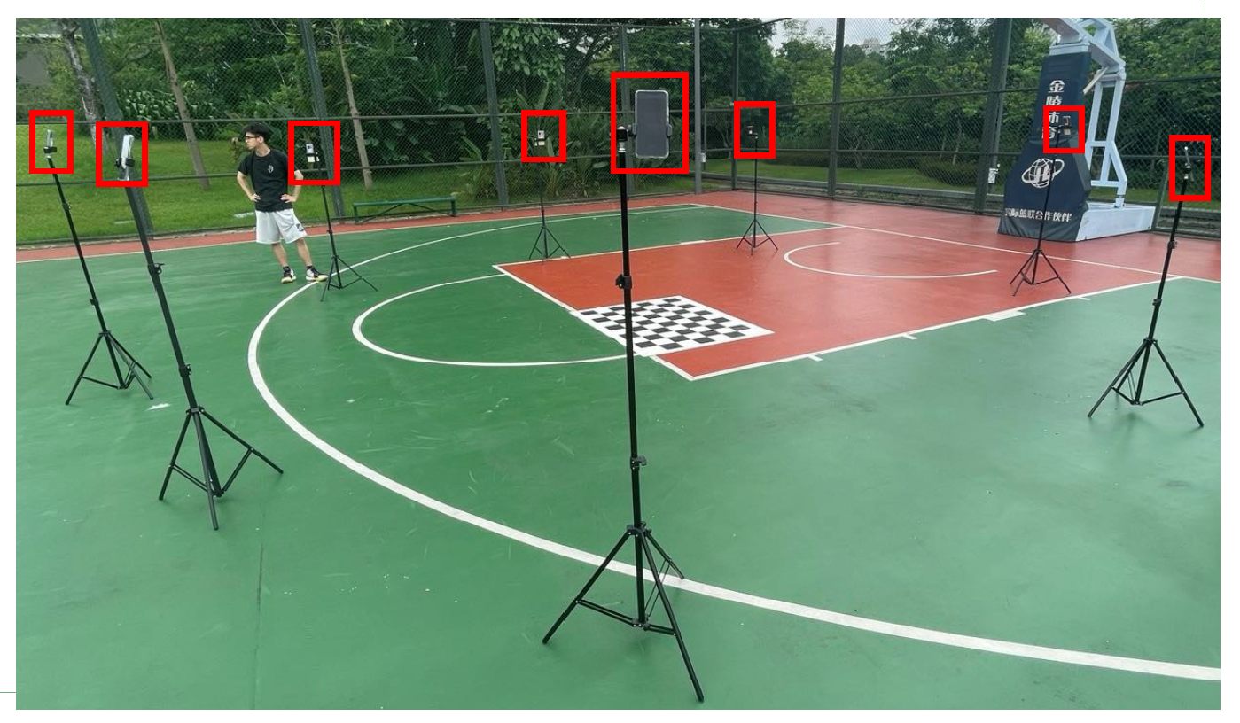
Introduction: From Motion Capture to Drone-Based Analysis
Motion Capture Systems (MoCap):
Require multiple calibrated cameras
Work in controlled environments
Image taken from “FreeMan: Towards Benchmarking 3D Human Pose Estimation under Real-World Conditions” [Wang et al., CVPR’24]
Notes:
Analisi Sportive con Sistemi di Cattura del Movimenti, molteplici camere fisse e calibrate poste intorno al soggetto.
Per ricostruire posa nello spazio 3D e movimento atletico.
Ambienti limitati e controllati

Slide 6
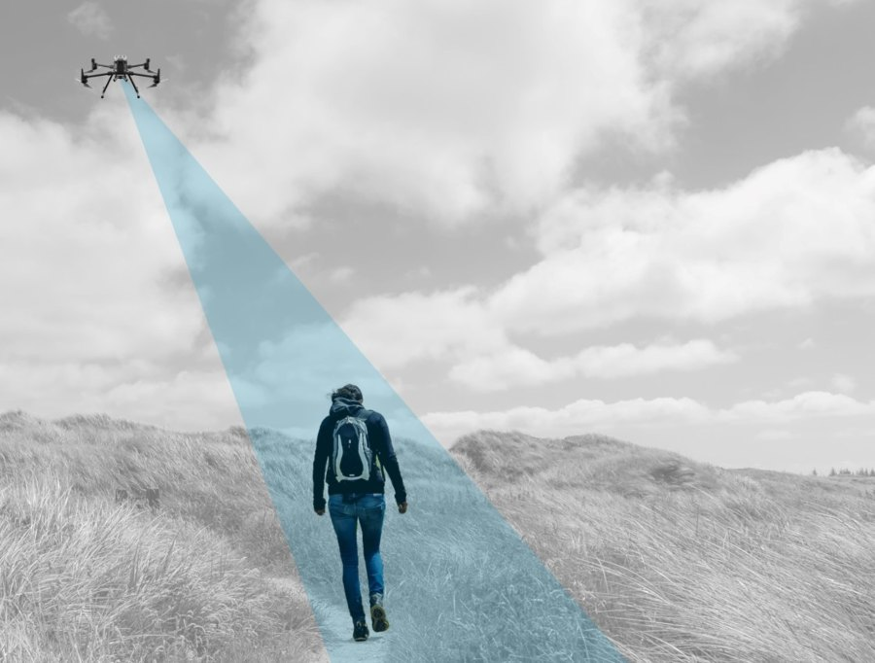
Introduction: From Motion Capture to Drone-Based Analysis
Motion Capture Systems (MoCap):
Require multiple calibrated cameras
Work in controlled environments
Image taken from “FreeMan: Towards Benchmarking 3D Human Pose Estimation under Real-World Conditions” [Wang et al., CVPR’24]
Outdoor sports often take place in environments where installing fixed camera systems is impractical.
Drone-Based Acquisition
Flexible viewpoints
Suitable for outdoor sports
Notes:
Sport all’aperto che abbiano bisogno di Vaste Aree
No camere fisse
Drone scelta interessante, essi possono Seguire l’atleta e lo hanno in primo piano Indipendentemente dall’Ambiente

Slide 7
Introduction: Thesis Objective
Problem
Limited solutions for drone-based motion capture systems in sports analysis and lack of large-scale aerial human pose estimation datasets.
Objective
Develop a Computer Vision model for 3D human motion reconstruction from drone footage, leveraging self-supervised learning to address data scarcity.
Notes:
Non esistono Grandi e Definite soluzioni per analisi del movimento da riprese aeree.
Non esistono grandi dataset pubblici per questo scopo.
Creazione di un modello di CV per ricostruzione 3D del Movimento Con approccio Auto-Supervisionato per contrastare la scarsita’ di dati.

Slide 8
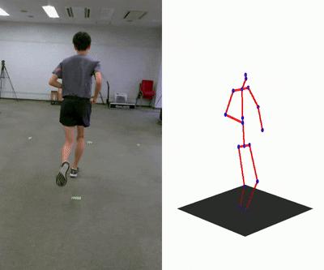
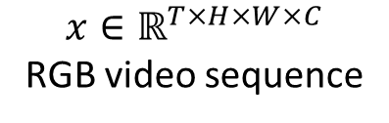
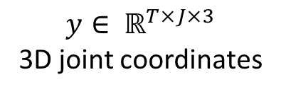
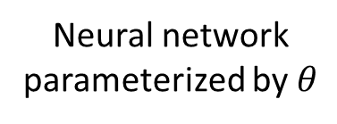
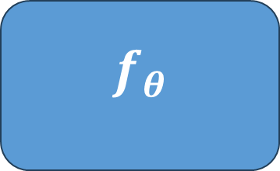
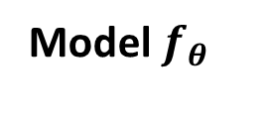
Problem Formulation
The goal of this thesis is to estimate the 3D motion of an athlete from monocular drone footage.
Input Video
3D Pose Sequence
Model $f_{θ}$
$$f_{θ}$$
Y
Neural network parameterized by $θ$
Z
X
$$y∈ ℝ^{T×J×3}$$
3D joint coordinates
$$x∈ℝ^{T×H×W×C}$$
RGB video sequence
Notes:
Video Monoculare di un singolo atleta.
Vogliamo ricostruire il movimento 3D.
Il modello di CV deve apprendere come mappare il video in input in una sequenza di pose 3D nello spazio in output.
La posa umana in HPE si ottiene individuando nella scena Sequenza di punti chiave che corrispondono alle articolazioni umane.
Unendo Punti Chiave si puo’ ottenere posa.

Slide 9
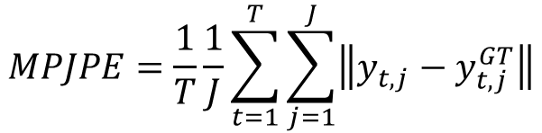
Problem Formulation
The learning objective is to minimize the discrepancy between predicted and ground-truth joint positions with the Mean Per Joint Position Error metric:
Y
$$MPJPE=\frac{1}{T}\frac{1}{J}\sum_{t=1}^{T}{\sum_{j=1}^{J}{\left\|y_{t,j}−y_{t,j}^{GT}\right\|}}$$
Z
X
Notes:
Obiettivo e’ minimizzare la Discrepanza tra punti predetti e punti reali.
Ottimizzando la metrica MPJPE
Spiega visivamente che cosa fa MPJPE.

Slide 10

Problem Formulation
The learning objective is to minimize the discrepancy between predicted and ground-truth joint positions with the Mean Per Joint Position Error metric:
P1 $=(x_{1},y_{1},z_{1})$
Y
$$MPJPE=\frac{1}{T}\frac{1}{J}\sum_{t=1}^{T}{\sum_{j=1}^{J}{\left\|y_{t,j}−y_{t,j}^{GT}\right\|}}$$
Predicted
Keypoint P1
Z
X
Notes:
Spiega visivamente che cosa fa MPJPE.

Slide 11

Problem Formulation
The learning objective is to minimize the discrepancy between predicted and ground-truth joint positions with the Mean Per Joint Position Error metric:
Ground-Truth Keypoint P2
P1 $=(x_{1},y_{1},z_{1})$
P2 $=(x_{2},y_{2},z_{2})$
Y
$$MPJPE=\frac{1}{T}\frac{1}{J}\sum_{t=1}^{T}{\sum_{j=1}^{J}{\left\|y_{t,j}−y_{t,j}^{GT}\right\|}}$$
Predicted
Keypoint P1
Z
X
Notes:
Spiega visivamente che cosa fa MPJPE.

Slide 12
Problem Formulation
The learning objective is to minimize the discrepancy between predicted and ground-truth joint positions with the Mean Per Joint Position Error metric:
Ground-Truth Keypoint P2
P1 $=(x_{1},y_{1},z_{1})$
P2 $=(x_{2},y_{2},z_{2})$
Y
$$MPJPE=\frac{1}{T}\frac{1}{J}\sum_{t=1}^{T}{\sum_{j=1}^{J}{\left\|y_{t,j}−y_{t,j}^{GT}\right\|}}$$
Predicted
Keypoint P1
Error to minimize
Z
X
Notes:
Spiega visivamente che cosa fa MPJPE.

Slide 13
Problem Formulation
The learning objective is to minimize the discrepancy between predicted and ground-truth joint positions with the Mean Per Joint Position Error metric:
Ground-Truth Keypoint P2
P1 $=(x_{1},y_{1},z_{1})$
P2 $=(x_{2},y_{2},z_{2})$
Y
$$MPJPE=\frac{1}{T}\frac{1}{J}\sum_{t=1}^{T}{\sum_{j=1}^{J}{\left\|y_{t,j}−y_{t,j}^{GT}\right\|}}$$
Predicted
Keypoint P1
Error to minimize
Z
X
Estimating 3D human pose from drone footage presents several challenges:
Motion blur and low resolution
Self-occlusions and partial visibility of the human body
Dynamic camera motion
Limited availability of labeled datasets
Notes:
Ambiguita’ Profondita’ e Perdita info Geometriche dovuta a monoculare.
Motion Blur e Bassa Risoluzione dovuti alla camera in movimento rendono piu’ difficile l’individuazione dei punti chiave.
Vista angolata causa Auto-Occlusione e Visibilita’ Parziale degli arti dell’atleta.

Slide 14
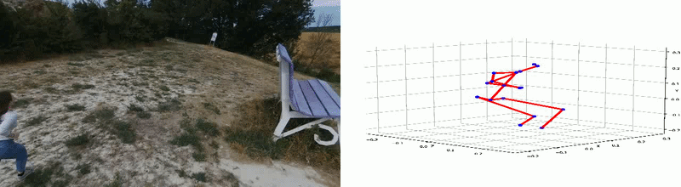
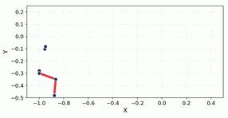
Proposed Method
First Stage: 2D Human Pose Extraction
2D Pose Extractor
RGB video sequence
2D sequence
Second Stage: 2D to 3D Human Pose Lifting
2D to 3D
Pose Lifter
2D sequence
3D sequence
Notes:
Soluzione proposta caratterizzata da Pipeline a due fasi.
Prima estrazione della sequenza di pose 2D dal video in input.
Secondo elevamento a 3D di sequenza di posa 2D.
Si veloce qui

Slide 15
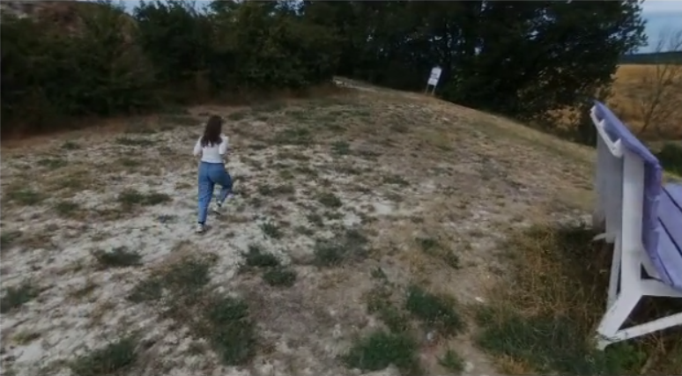
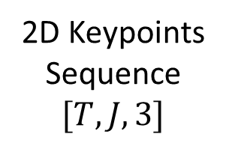
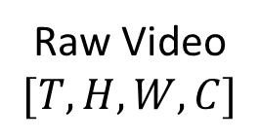
Proposed Method: First Stage
The first stage detects and extracts the 2D human pose from video data.
Resize and
Truncate
Human
Detector
2D Pose
Extractor
Keypoint
Normalizer
2D Keypoints
Sequence
$$[T,J,3]$$
Raw Video
$$[T,H,W,C]$$
Notes:
Prima Fase si Occupa di Estrarre la sequenza di pose 2D dal video.

Slide 16
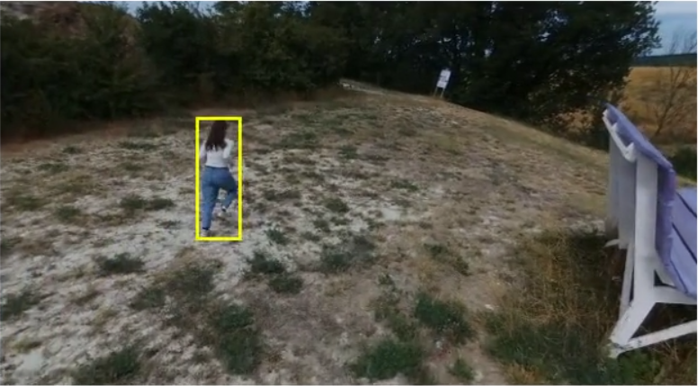
Proposed Method: First Stage
The first stage detects and extracts the 2D human pose from video data.
Resize and
Truncate
Human
Detector
2D Pose
Extractor
Keypoint
Normalizer
2D Keypoints
Sequence
$$[T,J,3]$$
Raw Video
$$[T,H,W,C]$$
Human Detector:
“Yolov12: Attention-centric real-time object detectors” [Tian et al., NeurIPS’25]
Notes:
Un modulo che Individua l’Atleta nella Scena, Ritaglia la sezione di frame del soggetto.

Slide 17
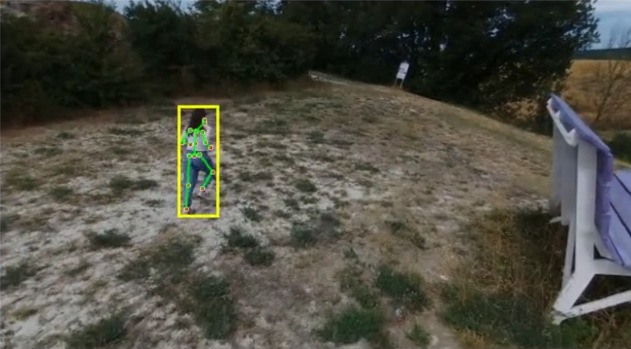
Proposed Method: First Stage
The first stage detects and extracts the 2D human pose from video data.
Resize and
Truncate
Human
Detector
2D Pose
Extractor
Keypoint
Normalizer
2D Keypoints
Sequence
$$[T,J,3]$$
Raw Video
$$[T,H,W,C]$$
Human Detector:
“Yolov12: Attention-centric real-time object detectors” [Tian et al., NeurIPS’25]
2D Pose Extractor:
“Vitpose: Simple vision transformer baselines for human pose estimation” [Xu et al., NeurIPS’22]
Notes:
Questa sezione viene passata ad un Modulo che estrae Ie articolazioni nello spazio 2D dell’imagine.

Slide 18
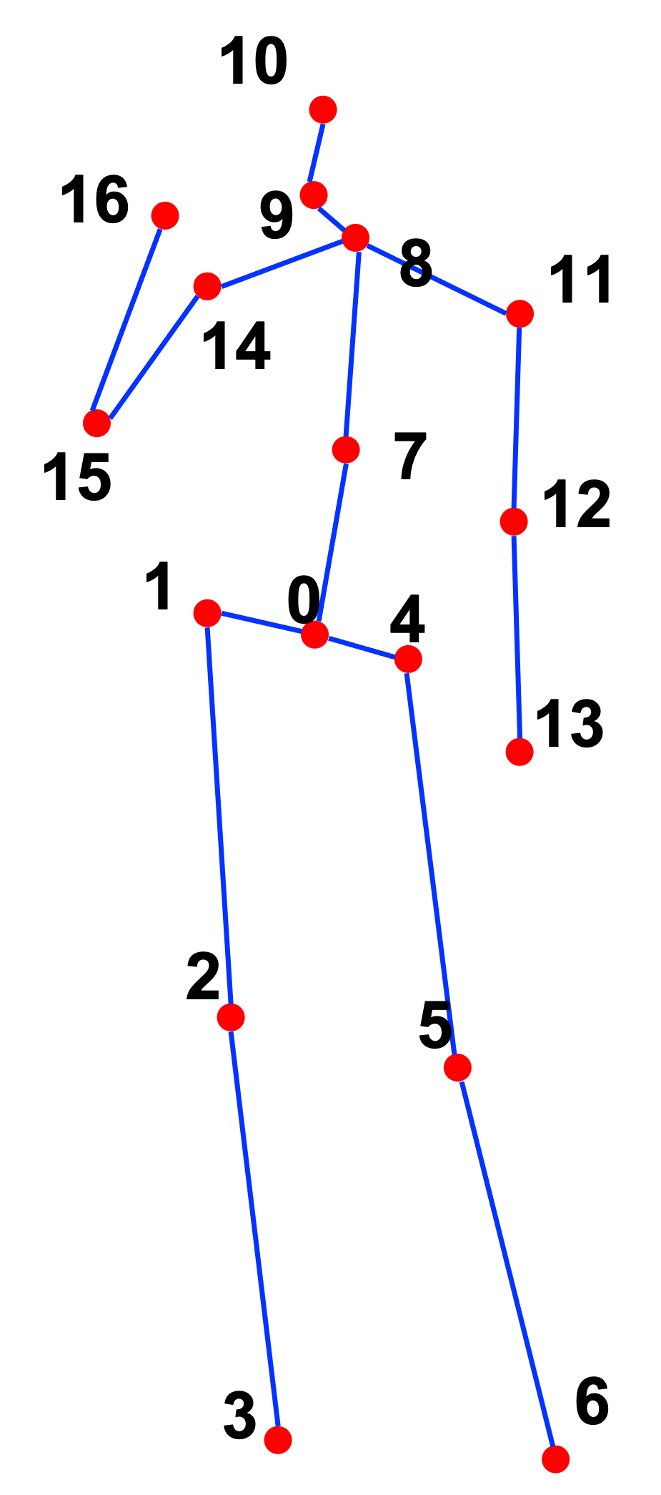







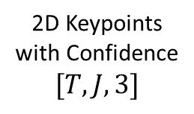

Proposed Method: Second Stage
Brancher is a neural network designed for single-person and single-view 3D pose estimation from aerial videos.
Pose
Branch
Spatial and Temporal Module
$$\hat{y}∈ ℝ^{T×J×3}$$
Spatial
GCN
Temporal GCN
$$R=r(\hat{y})$$
Rotation
Branch
Linear
Projection
$$[T,J,D]$$
$$[T,J,D]$$
Adaptive Fusion
$$\hat{R}∈ ℝ^{T×O×3×3}$$
Spatial
Position
Embedding
Spatial Transformer
Temporal Transformer
Uncertainty
Branch
$$×N$$
$$μ∈ ℝ^{T×J×H×W}$$
2D Keypoints with Confidence
$$[T,J,3]$$
$$\log\left(σ^{2}\right)∈ ℝ^{T×J×1}$$
Brancher introduces:
Spatial–temporal modeling of human motion
Multi-branch learning for complementary motion constraints
Self-supervised training for drone videos without 3D annotations
Notes:
Brancher NN per 3D HPE di un singolo atleta e vista monoculare aerea
Modellazione Spazio-Temporale del movimento atletico.
Design multi-ramo per ottimizzare aspetti complementari nella ricostruzione del movimento 3d dalle difficili riprese aeree.
4 output, ma ci interessa solo il primo, gli altri migliorano indirettamente il primo.
Modello auto-supervisionato.

Slide 19
Proposed Method: Spatial and Temporal Module
Pose
Branch
Spatial and Temporal Module
$$\hat{y}∈ ℝ^{T×J×3}$$
Spatial
GCN
Temporal GCN
$$R=r(\hat{y})$$
Rotation
Branch
Linear
Projection
$$[T,J,D]$$
$$[T,J,D]$$
Adaptive Fusion
$$\hat{R}∈ ℝ^{T×O×3×3}$$
Spatial
Position
Embedding
Spatial Transformer
Temporal Transformer
Uncertainty
Branch
$$×N$$
$$μ∈ ℝ^{T×J×H×W}$$
2D Keypoints with Confidence
$$[T,J,3]$$
$$\log\left(σ^{2}\right)∈ ℝ^{T×J×1}$$

Slide 20
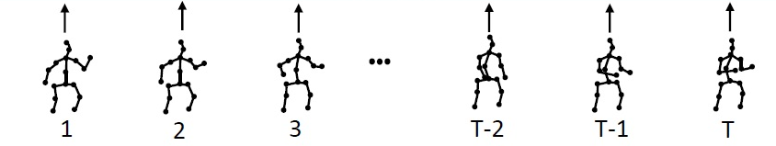




Proposed Method: Spatial and Temporal Module
This module jointly models temporal motion dynamics and spatial joint relationships.
$$[T,J,D]$$
MotionAGFormer Backbone
Adaptive Fusion
$$×N=26$$
Temporal GCNFormer
Temporal Transformer
Spatial GCNFormer
Spatial Transformer
Spatial Position Embedding
$$F∈ℝ^{T×J×D}+P∈ℝ^{1×J×D}$$
Linear Projection
$$[T,J,3]$$
“Motionagformer: Enhancing 3d human pose estimation with a transformer-gcnformer network.” [Mehraban et al., WACV’24]
Notes:
Dopo aver proiettato la sequenza 2d in uno spazio latente D
Con due meccanismi complementari:
Multi-Head Self Attention
Graph Convolutional Networks
Elabora spazio-temporalmente le informazione del movimento atletico con dipendenze sia globali che locali

Slide 21
Proposed Method: Pose Branch
Pose
Branch
Spatial and Temporal Module
$$\hat{y}∈ ℝ^{T×J×3}$$
Spatial
GCN
Temporal GCN
$$R=r(\hat{y})$$
Rotation
Branch
Linear
Projection
$$[T,J,D]$$
$$[T,J,D]$$
Adaptive Fusion
$$\hat{R}∈ ℝ^{T×O×3×3}$$
Spatial
Position
Embedding
Spatial Transformer
Temporal Transformer
Uncertainty
Branch
$$×N$$
$$μ∈ ℝ^{T×J×H×W}$$
2D Keypoints with Confidence
$$[T,J,3]$$
$$\log\left(σ^{2}\right)∈ ℝ^{T×J×1}$$

Slide 22


Proposed Method: Pose Branch
The Pose branch is responsible for regressing the 3D joint positions of the human subject.
$$[T,J,D]$$
Linear
Tanh
Linear
$$\hat{y}∈ℝ^{T×J×3}$$
Notes:
Regressione dei punti 3D corrispondenti alle articolazioni umane

Slide 23
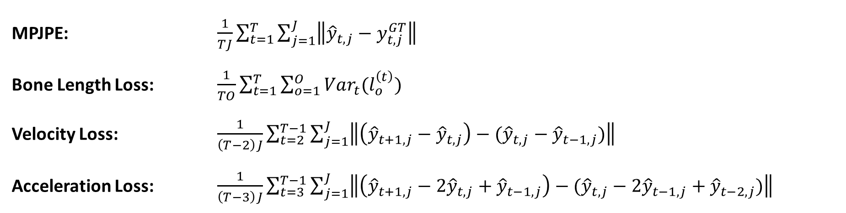
Proposed Method: Pose Branch
The Pose branch is responsible for regressing the 3D joint positions of the human subject.
$$[T,J,D]$$
Linear
Tanh
Linear
$$\hat{y}∈ℝ^{T×J×3}$$
MPJPE: $\frac{1}{TJ}\sum_{t=1}^{T}{\sum_{j=1}^{J}{\left\|{\hat{y}}_{t,j}−y_{t,j}^{GT}\right\|}}$
Bone Length Loss: $\frac{1}{TO}\sum_{t=1}^{T}{\sum_{o=1}^{O}{Var_{t}(l_{o}^{\left(t\right)})}}$
Velocity Loss: $\frac{1}{\left(T−2\right)J}\sum_{t=2}^{T−1}{\sum_{j=1}^{J}{\left\|\left({\hat{y}}_{t+1,j}−{\hat{y}}_{t,j}\right)−({\hat{y}}_{t,j}−{\hat{y}}_{t−1,j})\right\|}}$
Acceleration Loss: $\frac{1}{\left(T−3\right)J}\sum_{t=3}^{T−1}{\sum_{j=1}^{J}{\left\|\left({\hat{y}}_{t+1,j}−2{\hat{y}}_{t,j}+{\hat{y}}_{t−1,j}\right)−({\hat{y}}_{t,j}−2{\hat{y}}_{t−1,j}+{\hat{y}}_{t−2,j})\right\|}}$
Notes:
MPJPE, ripeti a voce
Variazione lunghezza delle ossa nella sequenza video
Variazione repentina velocita’ e accelerazione

Slide 24
Proposed Method: Rotation Branch
Pose
Branch
Spatial and Temporal Module
$$\hat{y}∈ ℝ^{T×J×3}$$
Spatial
GCN
Temporal GCN
$$R=r(\hat{y})$$
Rotation
Branch
Linear
Projection
$$[T,J,D]$$
$$[T,J,D]$$
Adaptive Fusion
$$\hat{R}∈ ℝ^{T×O×3×3}$$
Spatial
Position
Embedding
Spatial Transformer
Temporal Transformer
Uncertainty
Branch
$$×N$$
$$μ∈ ℝ^{T×J×H×W}$$
2D Keypoints with Confidence
$$[T,J,3]$$
$$\log\left(σ^{2}\right)∈ ℝ^{T×J×1}$$

Slide 25
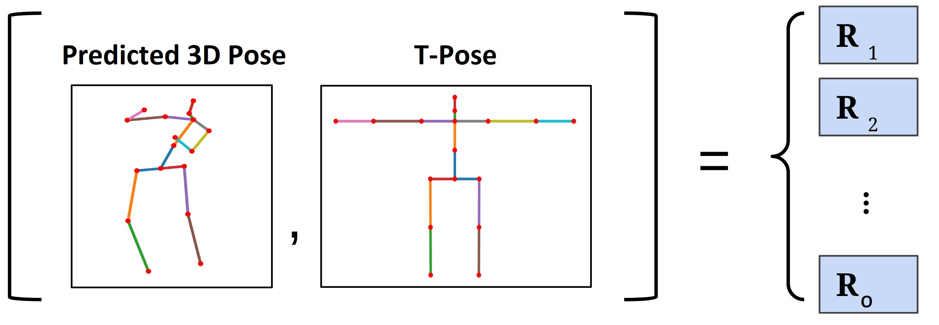



Proposed Method: Rotation Branch
The Rotation Branch is responsible for estimating the joint rotations of the human body.
Gram-Schmidt
Orthonormalization
Process
$$[T,J,D]$$
Linear
Tanh
$$\hat{R}∈ ℝ^{T×O×3×3}$$
$$[D×J→O×6]$$
“On the continuity of rotation representations in neural networks.” [Zhou et al., CVPR’19]
Notes:
Ha il compito di predirre le rotazioni degli arti dell’atleta che lo riportano dalla posa Corrente ad una generica Tpose.
Studi empirici dimostrato che permettendo spazio latent di apprendere informazioni riguardo la rotazione degli arti migliora anche la posa 3D.
Dunque per predirre le rotazioni, il ramo utilizza una rappresentazione a 6D che viene poi trasformata in una matrice di rotazione dal metodo di ortonormalizzazione

Slide 26






Proposed Method: Rotation Branch
The Rotation Branch is responsible for estimating the joint rotations of the human body.
$$R$$
Pose
Branch
$$\vec{a}$$
Y
$$\hat{y}∈ ℝ^{T×J×3}$$
X
$$\vec{b}$$
$$R=r(\hat{y})$$
Z
Gram-Schmidt
Orthonormalization
Process
Geodesic
Loss
$$[T,J,D]$$
Linear
Tanh
$$\hat{R}∈ ℝ^{T×O×3×3}$$
$$[D×J→O×6]$$
Geodesic Loss: $\frac{1}{TO}\sum_{t=1}^{T}{\sum_{o=1}^{O}{arccos⁡\left(\frac{tr({\hat{R}}_{t,o}R_{t,o}^{T})−1}{2}\right)}}$
“On the continuity of rotation representations in neural networks.” [Zhou et al., CVPR’19]
Notes:
Come segnale di supervision, prendiamo l’output della posa 3D dell’atlteta dal precedente ramo e Andiamo a calcolare per ogni arto la matrice di rotazione che lo allinea a quello della generica T-Pose.
Infine, con la Geodeisca Andiamo a calcolare in maniera auto-supervisionata le differenze tra le matrici di rotazione predette e quelle calcolate.

Slide 27
Proposed Method: Uncertainty Branch
Pose
Branch
Spatial and Temporal Module
$$\hat{y}∈ ℝ^{T×J×3}$$
Spatial
GCN
Temporal GCN
$$R=r(\hat{y})$$
Rotation
Branch
Linear
Projection
$$[T,J,D]$$
$$[T,J,D]$$
Adaptive Fusion
$$\hat{R}∈ ℝ^{T×O×3×3}$$
Spatial
Position
Embedding
Spatial Transformer
Temporal Transformer
Uncertainty
Branch
$$×N$$
$$μ∈ ℝ^{T×J×H×W}$$
2D Keypoints with Confidence
$$[T,J,3]$$
$$\log\left(σ^{2}\right)∈ ℝ^{T×J×1}$$

Slide 28
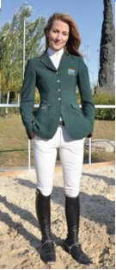





Proposed Method: Uncertainty Branch
Bayesian modeling of joints as Gaussian distributions $(μ,σ^{2})$ to handle uncertainty and occlusions.
$$×2$$
$$×2$$
Linear
LReLU
Upconv
BN
ReLU
Upconv
Sigmoid
$$μ∈ ℝ^{T×J×H×W}$$
$$[T,J,D]$$
Linear
$$s=log\left(σ^{2}\right)∈ ℝ^{T×J×1}$$
Adapted from
Dang et al.
“What uncertainties do we need in bayesian deep learning for computer vision?” [Kendall et al., NeurIPS’17]
Notes:
Come gia’ citato Occlusione e Visibilita’ Parziale degli arti dell’atleta, in viste aeree sono problemi.
Per far si che il modello sia robusto a tutto cio’ e tenga conto dell’incertezza dei dati in input da fase precedente, e’ necessario modellare Incertezza Eteroschedastica di questi input.

Slide 29
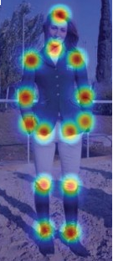

Proposed Method: Uncertainty Branch
Bayesian modeling of joints as Gaussian distributions $(μ,σ^{2})$ to handle uncertainty and occlusions.
$$×2$$
$$×2$$
Linear
LReLU
Upconv
BN
ReLU
Upconv
Sigmoid
$$μ∈ ℝ^{T×J×H×W}$$
$$[T,J,D]$$
Linear
$$s=log\left(σ^{2}\right)∈ ℝ^{T×J×1}$$
$$μ$$
Adapted from
Dang et al.
“What uncertainties do we need in bayesian deep learning for computer vision?” [Kendall et al., NeurIPS’17]
Notes:
Per fare cio’ va a predirre una hm per ogni articolazione, il che corrisponde ad una distribuzione di probabilita’ sull’immagine riguardo la presenza dei giunti umani, abbinata ad una varianza per modellare l’incertezza.

Slide 30
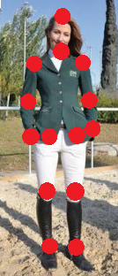

Proposed Method: Uncertainty Branch
Bayesian modeling of joints as Gaussian distributions $(μ,σ^{2})$ to handle uncertainty and occlusions.
$$×2$$
$$×2$$
Linear
LReLU
Upconv
BN
ReLU
Upconv
Sigmoid
$$μ∈ ℝ^{T×J×H×W}$$
$$[T,J,D]$$
Linear
$$s=log\left(σ^{2}\right)∈ ℝ^{T×J×1}$$
$x=$ soft-argmax$(μ)$
Adapted from
Dang et al.
“What uncertainties do we need in bayesian deep learning for computer vision?” [Kendall et al., NeurIPS’17]
Notes:
Possiamo dunque estrarre posizione articolazioni sulla scena 2D

Slide 31

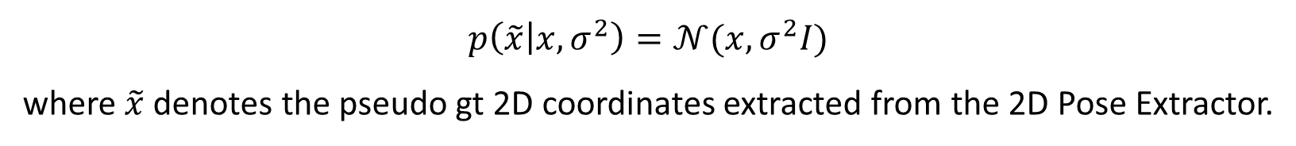
Proposed Method: Uncertainty Branch
Bayesian modeling of joints as Gaussian distributions $(μ,σ^{2})$ to handle uncertainty and occlusions.
$$×2$$
$$×2$$
Linear
LReLU
Upconv
BN
ReLU
Upconv
Sigmoid
$$μ∈ ℝ^{T×J×H×W}$$
$$[T,J,D]$$
Linear
$$s=log\left(σ^{2}\right)∈ ℝ^{T×J×1}$$
$x=$ soft-argmax$(μ)$
$p\left(\tilde{x} | x,σ^{2}\right)=𝒩(x,σ^{2}I)$
where $\tilde{x}$denotes the pseudo gt 2D coordinates extracted from the 2D Pose Extractor.
HM Loss: $\frac{1}{2}\sum_{j=1}^{J}{(e^{−s_{j}}{\left\|x_{j}−\tilde{x_{j}}\right\|}^{2}+s_{j})}$
Adapted from
Dang et al.
“What uncertainties do we need in bayesian deep learning for computer vision?” [Kendall et al., NeurIPS’17]
Notes:
Utilizzando I risultati provenienti dalla prima fase della pipeline, possiamo far si che il modello impari che certe articolazioni in input hanno in generale una variabilita’ Maggiore di altri, al fine da avere una ricostruzione piu’ fluida del movimento

Slide 32
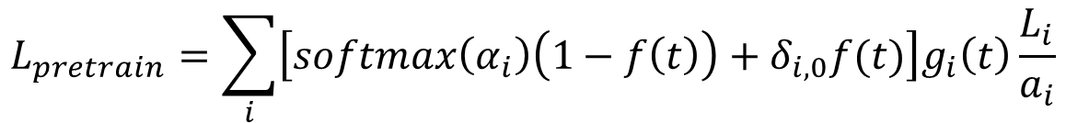
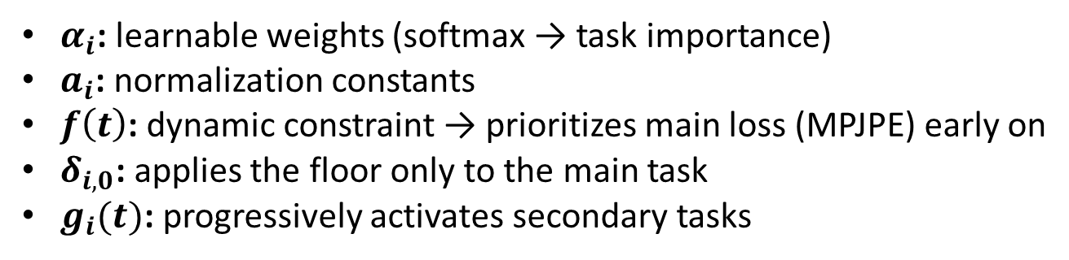
Proposed Method: Loss Weighting Strategy
Heterogeneous loss scales require balanced weighting for stable training.
Supervised Pretraining
During supervised pretraining, the objective is to stabilize the learning of 3D pose reconstruction before introducing strong self-supervised constraints.
$$L_{pretrain}=\sum_{i}{\left[softmax\left(α_{i}\right)\left(1−f\left(t\right)\right)+δ_{i,0}f(t)\right]g_{i}\left(t\right)\frac{L_{i}}{a_{i}}}$$
$α_{i}$: learnable weights (softmax → task importance)
$a_{i}$: normalization constants
$f\left(t\right)$: dynamic constraint → prioritizes main loss (MPJPE) early on
$δ_{i,0}$: applies the floor only to the main task
$g_{i}(t)$: progressively activates secondary tasks
Notes:
Abbiamo suddiviso l’addestramento della rete in due fasi: Supervisionata e Puramente Auto-Supervisionata.
Inoltre per bilanciare tutte le funzioni elencate molto eterogenee tra loro, abbiamo utilizzato due diversi wrapper.
Il wrapper delle fase supervisionata fa si che l’80% del gradiente sia dominato dalla funzione supervisionata MPJPE

Slide 33
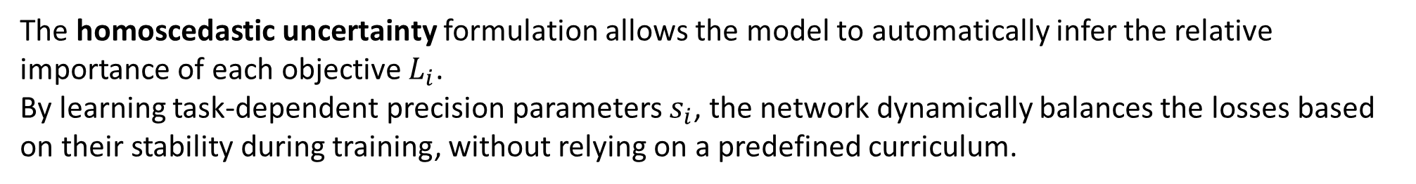

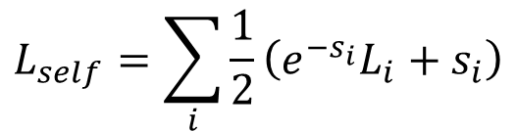
Proposed Method: Loss Weighting Strategy
Pure Self-Supervised Training
In purely self-supervised training, supervision signals are inherently indirect and noisier, making manual task hierarchies less reliable.
$$L_{self}=\sum_{i}{\frac{1}{2}\left(e^{−s_{i}}L_{i}+s_{i}\right)}$$
where $s_{i}=\log\left(σ_{i}^{2}\right)$ is the log variance
The homoscedastic uncertainty formulation allows the model to automatically infer the relative importance of each objective $L_{i}$.
By learning task-dependent precision parameters $s_{i}$, the network dynamically balances the losses based on their stability during training, without relying on a predefined curriculum.
“Multi-Task Learning Using Uncertainty to Weigh Losses for Scene Geometry and Semantics.” [Kendall et al., CVPR’18]
Notes:
Mentre nella parte autosupervisionata, viene utilizzato un wrapper che va a modellare l’incertezza omoschedastica delle varie operazioni, affinche il modello impari a bilanciare queste in totale autonomia

Slide 34
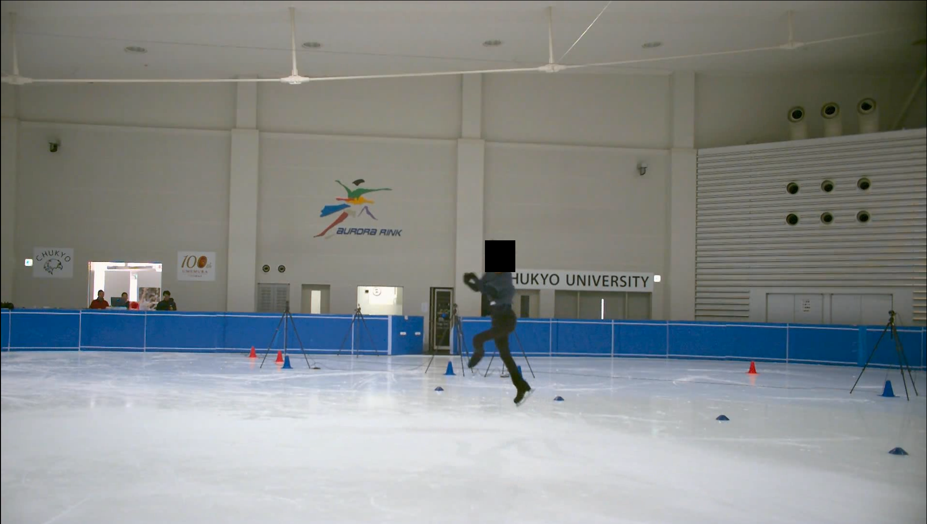
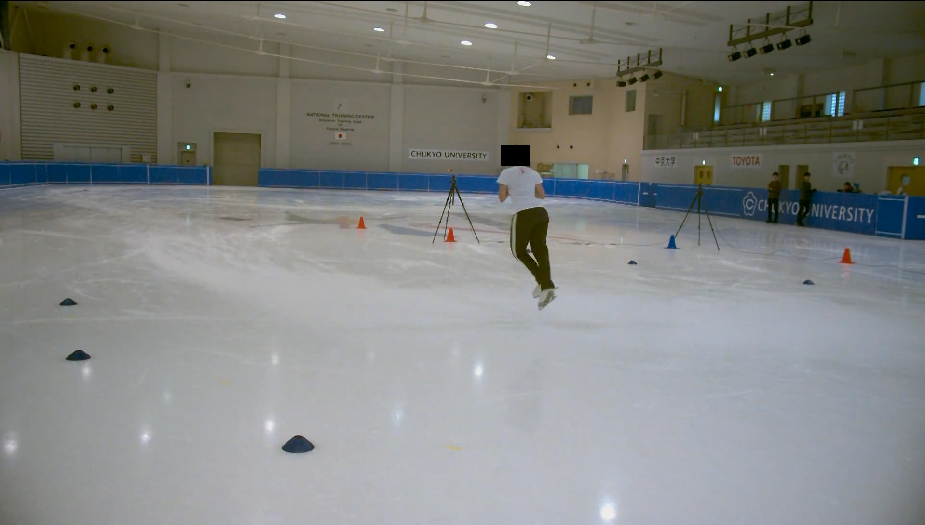
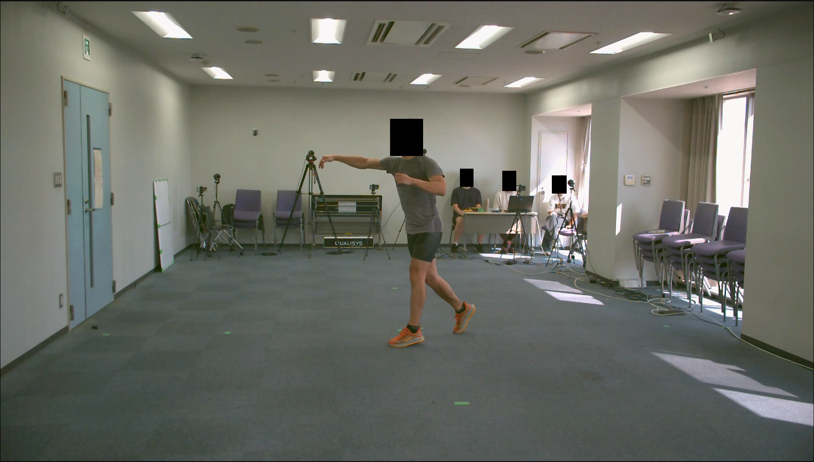
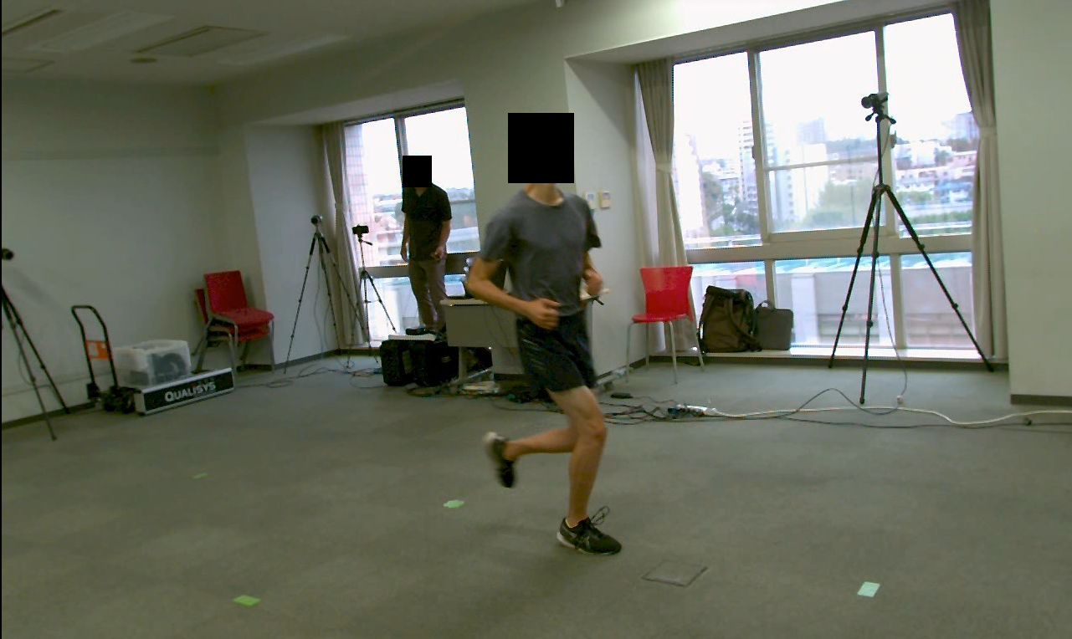
Experiments: Datasets
Supervised Pretraining
Pretraining is performed on the AthletePose3D dataset.
1.3M frames
2 different locations
8 distinctive subjects
“AthletePose3D: A Benchmark Dataset for 3D Human Pose Estimation and Kinematic Validation in Athletic Movements.” [Yeung et al., CVPR’25]
Notes:
Per l’addestramento della fase superivisionata, abbiamo scelto il dataset AthletePose3D realizzato dai suoi autori, catturando diversi movimenti atletici ad alta velocita’, come per esempio il pattinaggio di figura

Slide 35
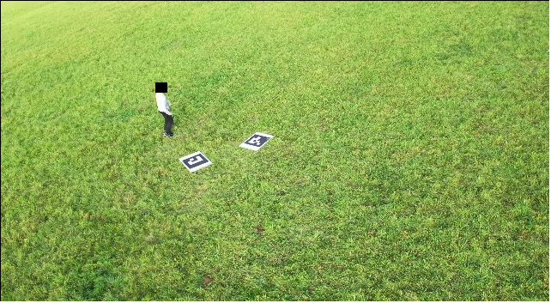
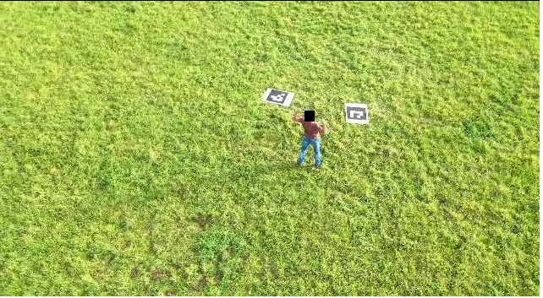
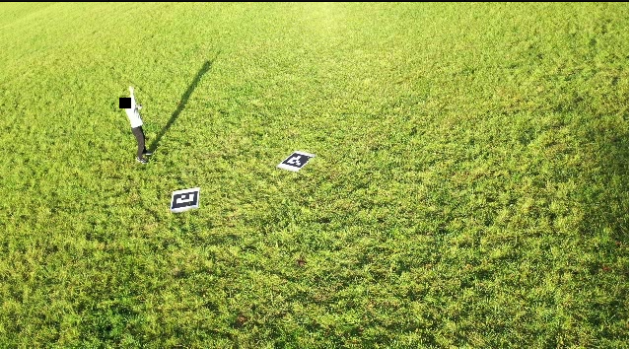
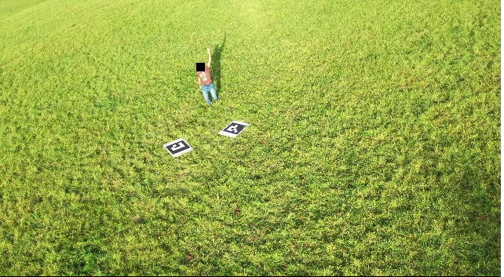
Experiments: Datasets
Pure Self-Supervised Training
A small drone dataset, provided by Saini et al., is leveraged for self-supervised training.
51 030 frames
2 distinct subjects
“Airpose: Multi-view fusion network for aerial 3d human pose and shape estimation.” [Saini et al., RA-L’22]
Notes:
Per la parte autosupervisionata

Slide 36
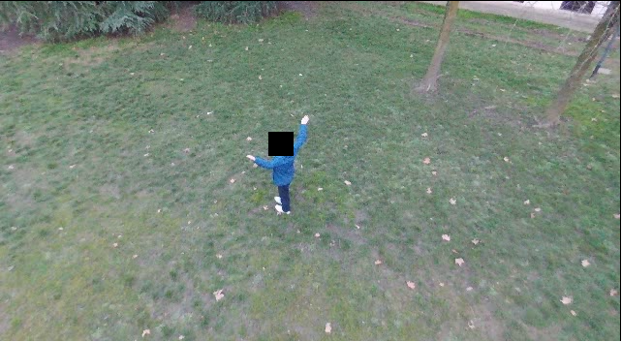
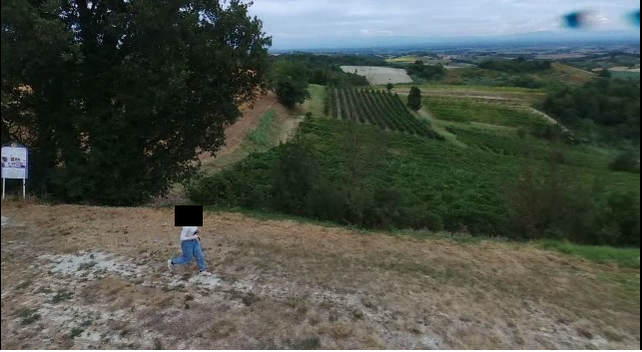
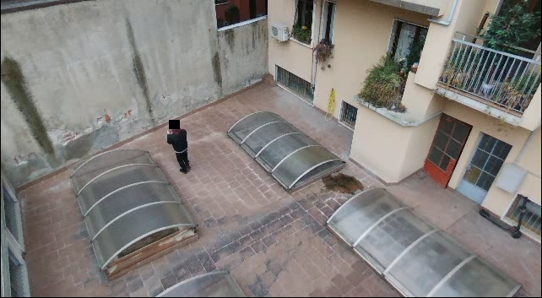
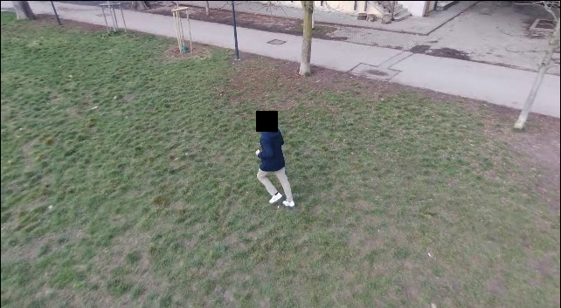
Experiments: Datasets
Pure Self-Supervised Training
Due to the lack of drone-captured videos, we built our own drone dataset, without 3D annotations.
56 538 frames
5 different locations
5 distinct subjects
Notes:
Nostro dataset realizzato con drone commerciale, in 5 differenti locazioni e con 5 differenti soggetti

Slide 37
Experiments: Quantitative Results
Quantitative comparison performed on the AthletePose3D test set.
Model | MPJPE (mm) ↓
MotionAGFormer | 160.6560
MotionAGFormer Finetuned | 14.1359
Pose Branch | 22.0248
Pose Branch and Rotation Branch | 20.8884
Pose Branch and Uncertainty Branch | 35.9176
Brancher | 30.9958
Brancher Self-Supervised Finetuned | 41.1452
Notes:
Non avevamo un benchmark aereo 3d per testare il nostro modello.
Possiamo notare che AGFormer ottiene peggio di tutti I nostri modelli, ma ft a livello numeric ottiene risultati migliori
Possiamo notare come a prima vista sembra che il ramo dell’incertezza e il modello completo sembrino sottoperformare.
In questo studio I risultati qualitativi sono piu’ indicativi

Slide 38
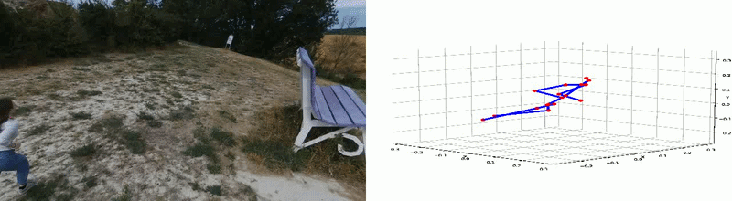
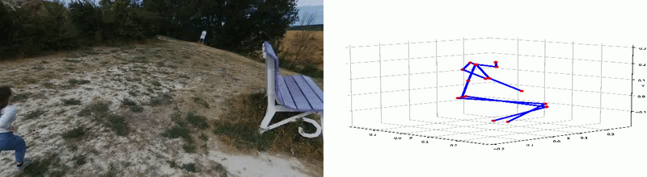
Experiments: Qualitative Results, MotionAGFormer
Original MotionAGFormer trained on Human3.6M dataset [Ionescu et al., TPAMI’14]
MotionAGFormer Finetuned on AthletePose3D dataset
Notes:
Inadeguato per analisi sportiva aerea

Slide 39
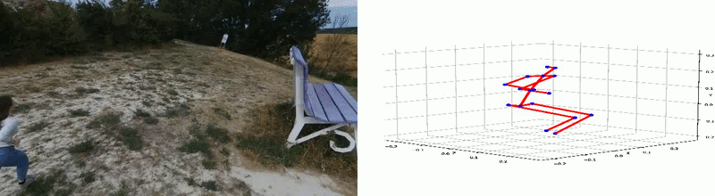

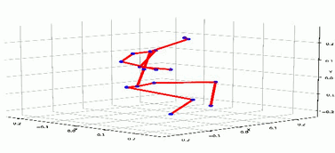
Experiments: Qualitative Results, Ablation Study
Pose Branch
Pose Branch and Rotation Branch
Pose Branch and Uncertainty Branch
Notes:
Posa da una buona ricostruzione
Rotazione va a scatti.
Incertezza introduce molta fluidita’ al movimento.

Slide 40
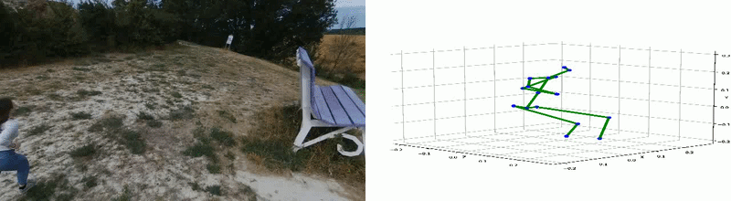
Experiments: Qualitative Results, Brancher
Brancher
Brancher Pure Self-Supervised on Drone Dataset
Notes:
Possiamo Vedere in alto il modello brancher complete dopo la fase supervisionata.
Sotto il modello dopo la fase puramente autosupervisionata su dataset aereo
Possiamo notare che fase puramente autosupervisionata introduce alcune anomalie

Slide 41
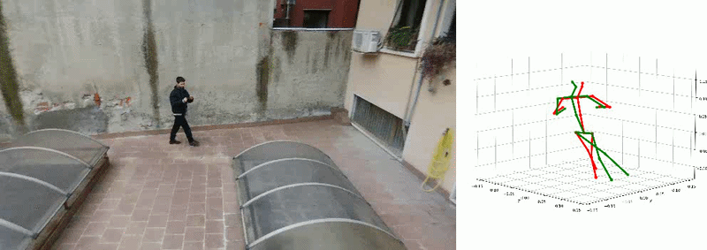
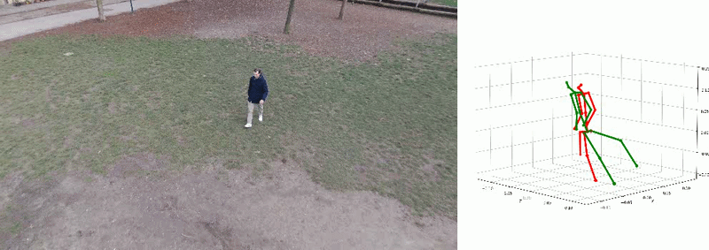


Experiments: Limitations of Brancher
Purely self-supervised training can sometimes underperform compared to the partially self-supervised trained model, highlighting its current limitations. This exposes the challenges of relying solely on indirect supervision in 3D human pose estimation.
Notes:
Possiamo notare nei seguenti frame che sebbene in alcuni casi, la ricostruzione 3D e’ Migliore dopo la fase autosupervisionata, in altri casi invece addirittura peggiora.
Questa e’ una limitazione dell’addestramento puramente autosupervisionato, che non avendo piu’ informazioni spaziali esterne, va ad ottimizzare obiettivi che non necessariamente portano ad avere una Migliore rappresentazione 3d

Slide 42
Conclusion
What has been done:
To the best of our knowledge, Brancher is the first deep learning model to tackle 3D Human Pose Estimation from monocular drone-captured videos.
We introduce a novel aerial dataset of human subjects acquired via drone.
Future Work:
Progress in drone-based 3D Human Pose Estimation critically depends on the creation of a large-scale dataset with accurate 3D annotations
Notes:
Brancher primo modello che usa DL per 3D HPE aerea.
Introdotto un nostro piccolo dataset aereo
Propongo la creazione del primo dataset aereo con notazioni 3d che beneficerebbe all’intera causa della 3D HPE aerea

Slide 43
Conclusion
Thank you for your attention

